Slide 1
NarVis: How to present a visualization in a bottom-up method?

Slide 2
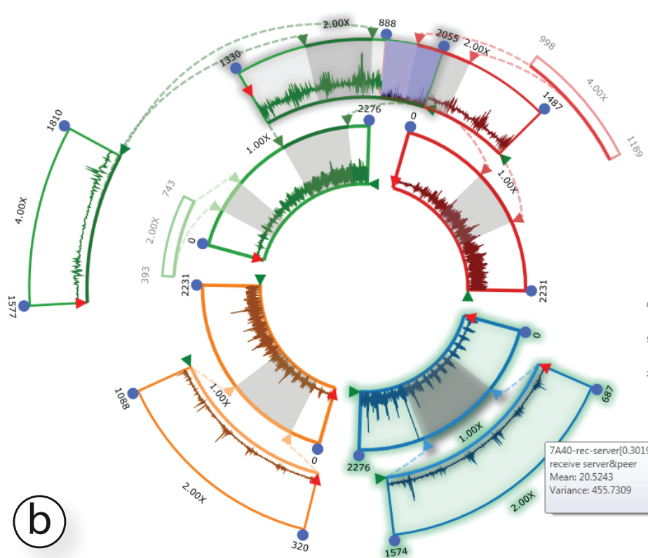
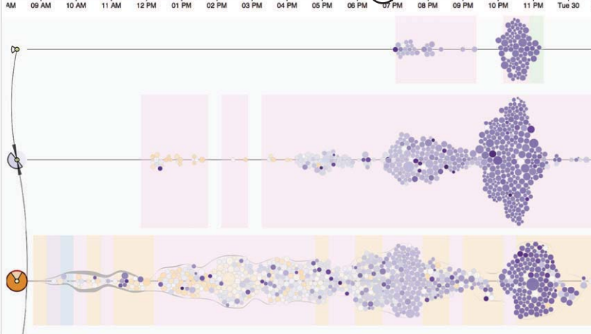
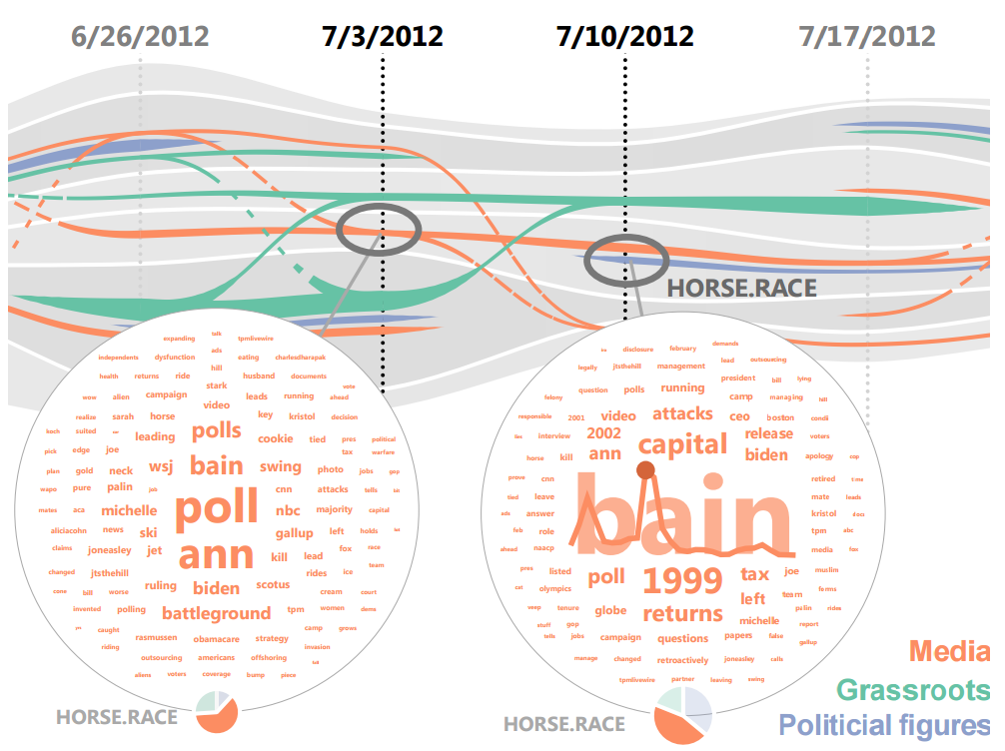
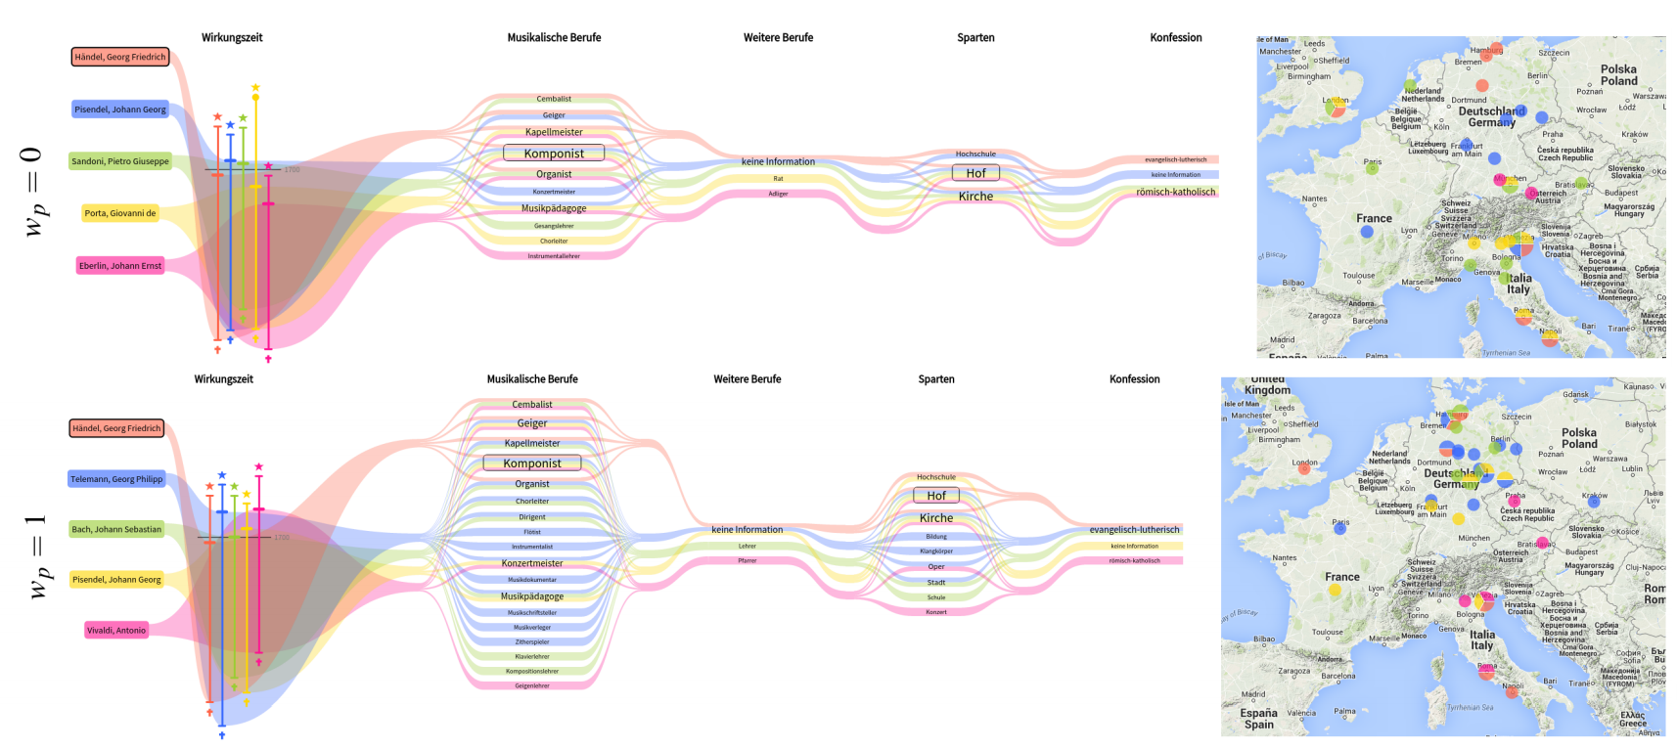
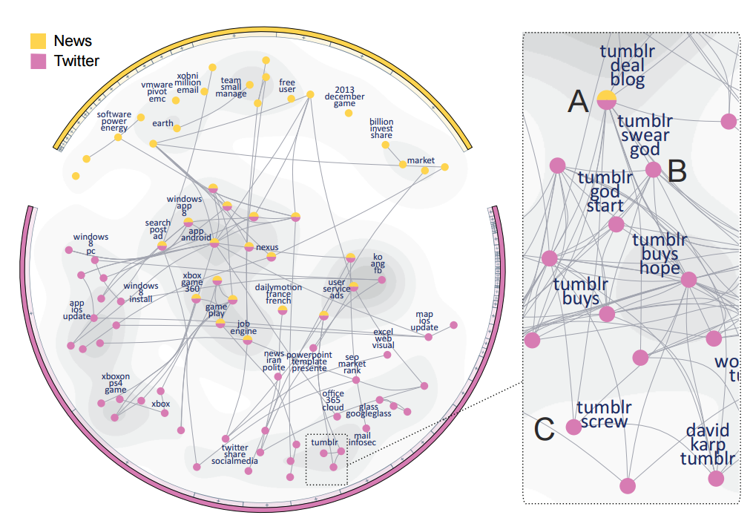
Yet require a tedious trial and error process to learn
Emerging new visualization designs
Efficient
How to present a visualization design effectively?

Slide 3
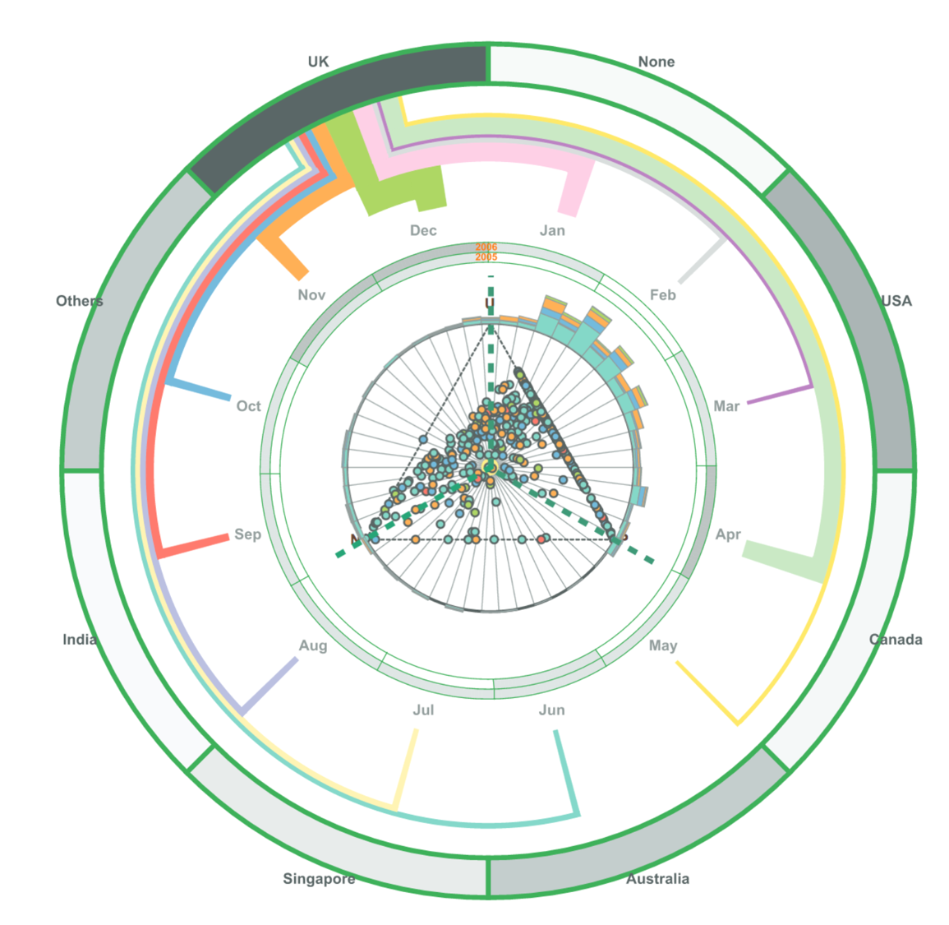
A visualization
Scatter plot
Node
Stacked bar chart
Bar
Visual units
Visual primitives
Mark + channels
Calendar ring
Geo ring
Grid
Wedge
Line
Point
Color
position
Rectangle
Color
Position
Height
Arc
Color
Arc
Color
Line
Color
Width
position
Notes:
To give a efficient high-level explanation model, wo

Slide 4
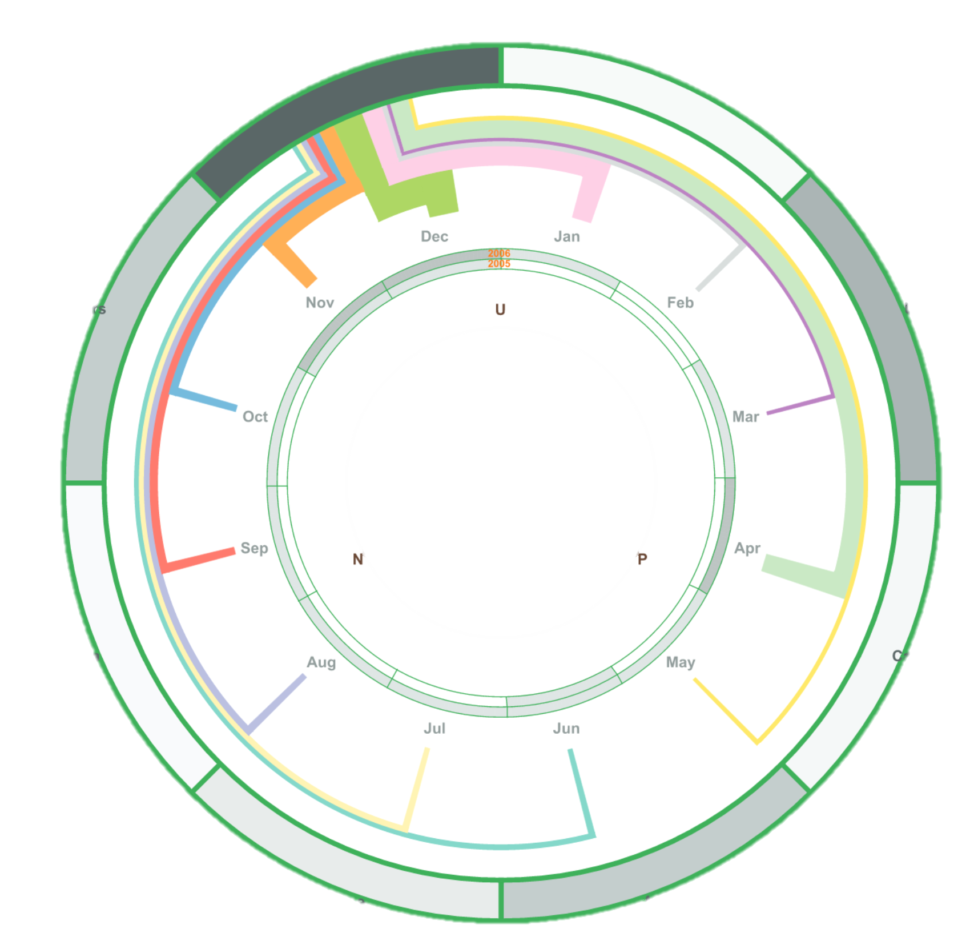
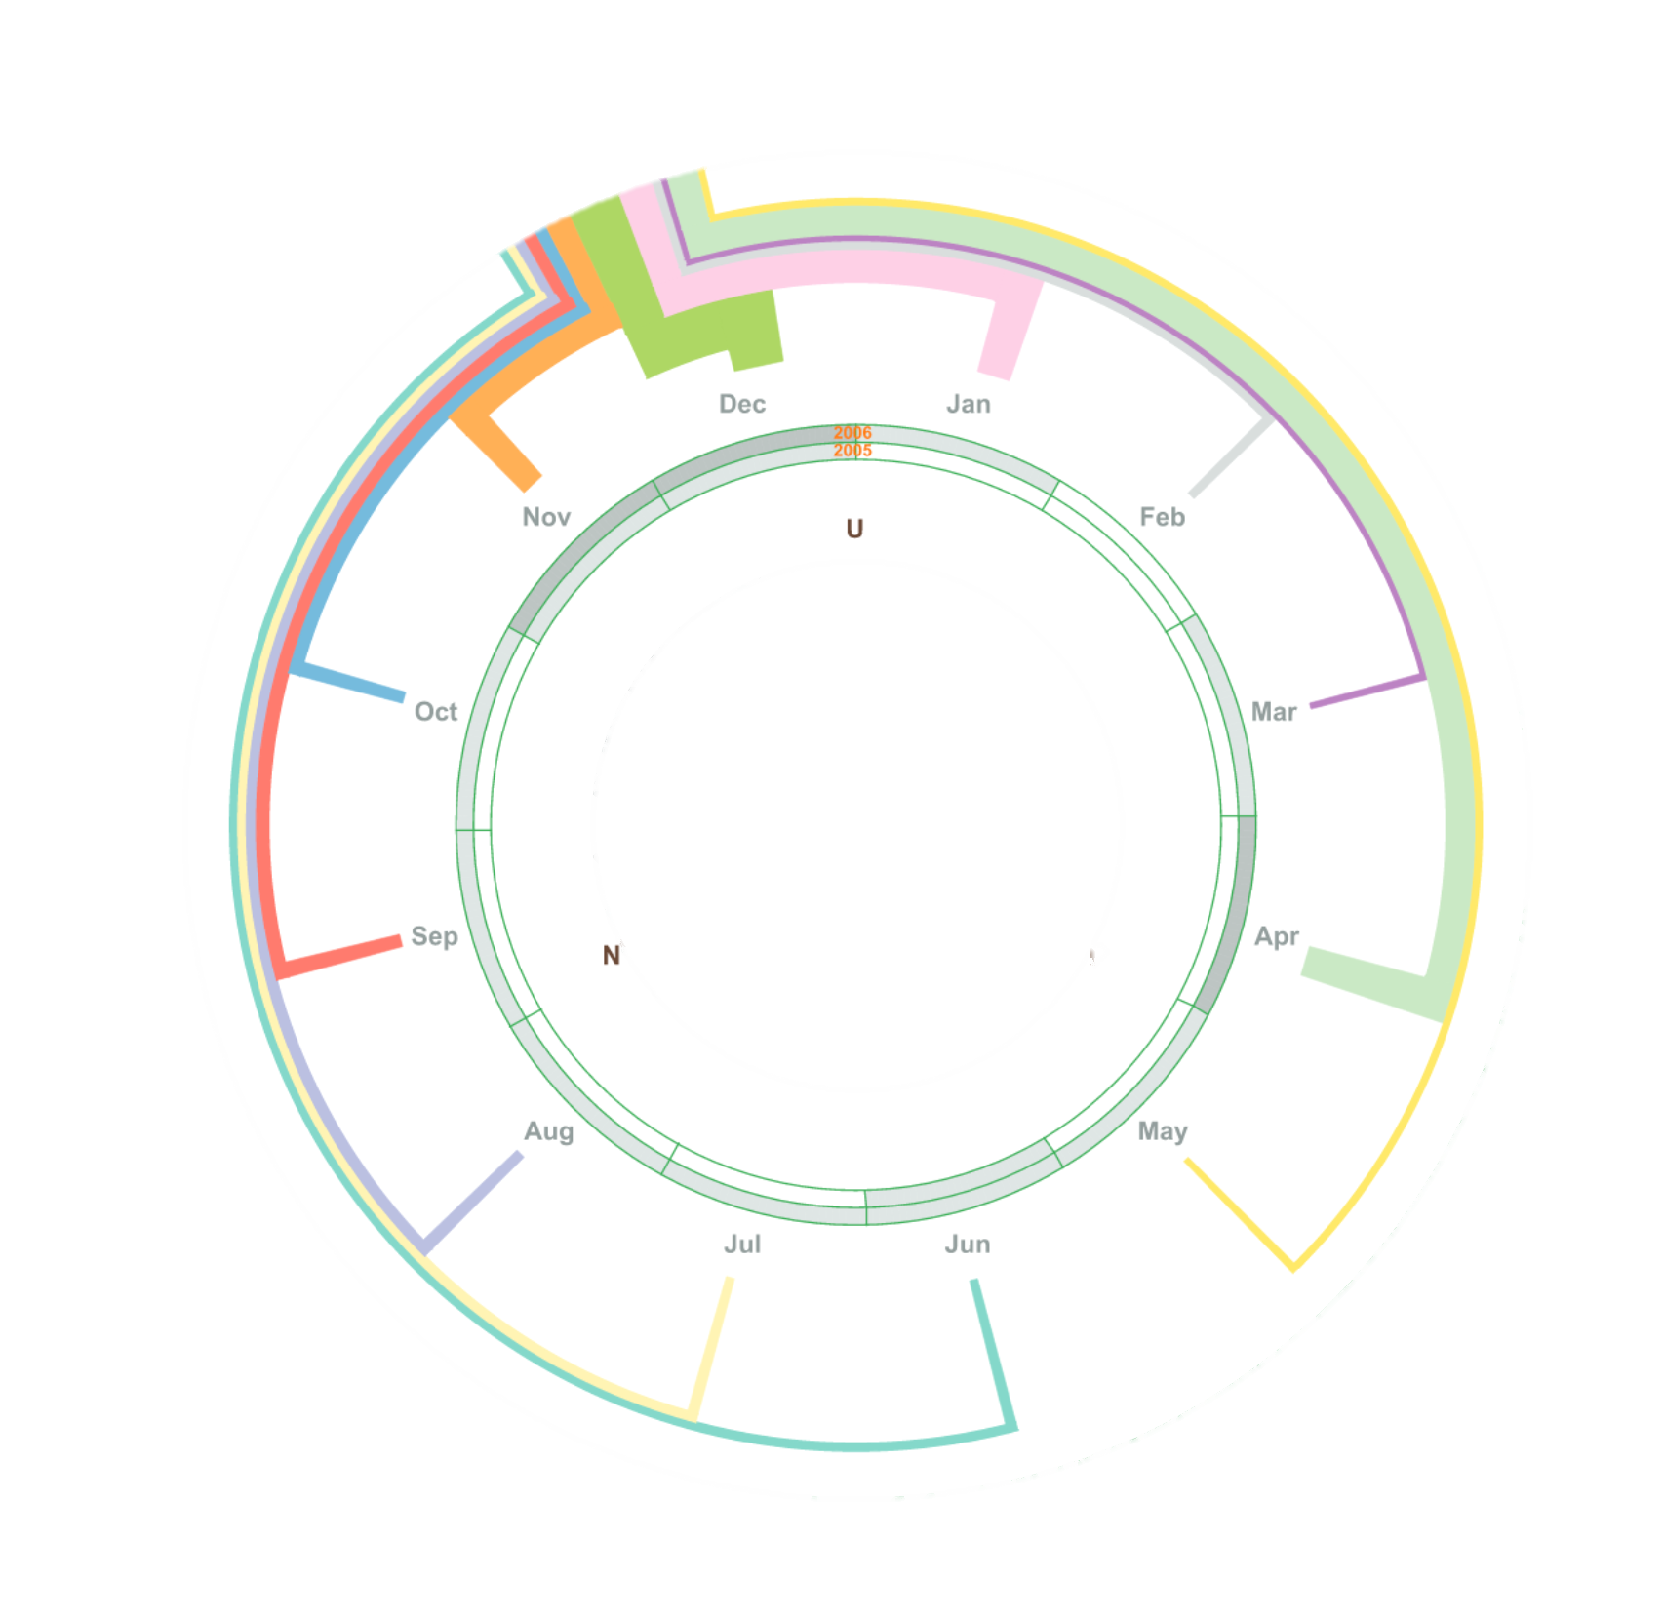
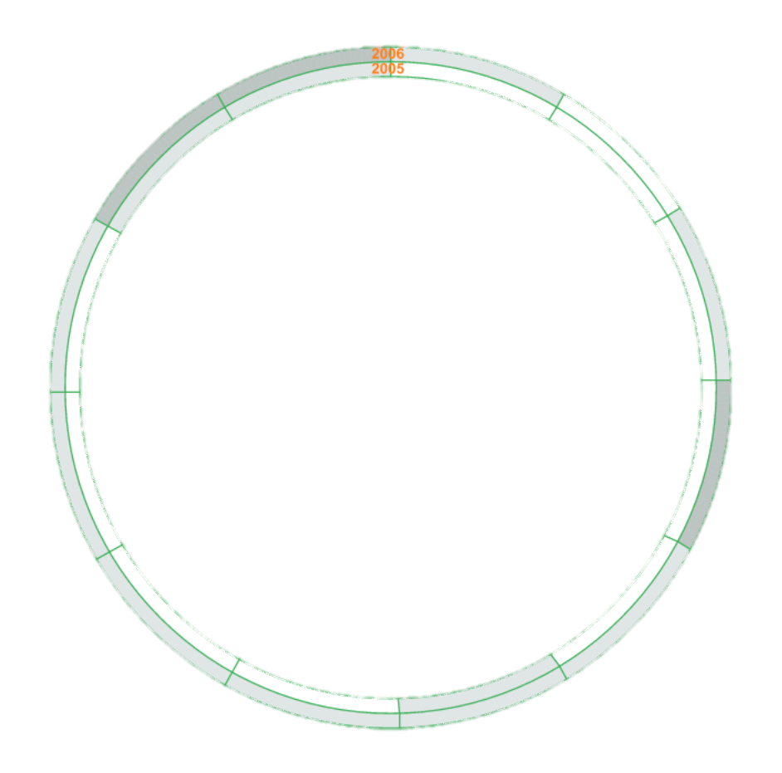
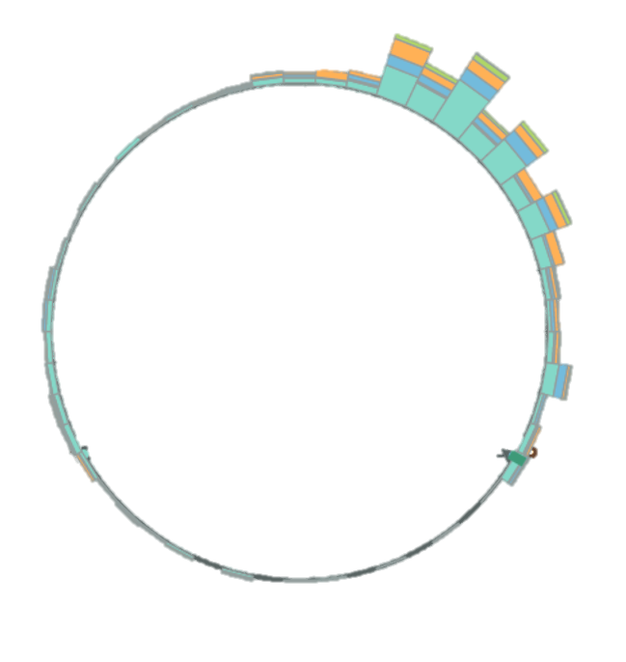
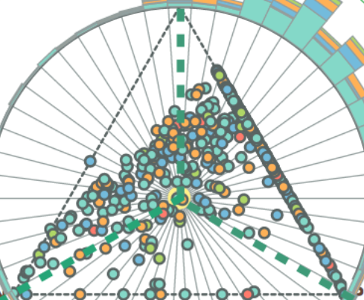

Slide 6
Triangle scatter plot
Opinion wheel
Stacked bar chart
Logic independency
Enhancement
Calendar ring
Connecting
line
Geo ring
Logic
dependency

Slide 7
Opinion wheel
Stacked bar chart
Calendar ring
Connecting
line
Triangle scatter plot
Geo ring

Slide 8
Opinion wheel
Stacked bar chart
Mark,
Position,
Color
Calendar ring
Connecting
line
Triangle scatter plot
Geo ring

Slide 9
Opinion wheel
Stacked bar chart
Calendar ring
Connecting
line
Triangle scatter plot
Geo ring

Slide 10
Triangle scatter plot
Opinion wheel
Stacked bar chart
Calendar ring
Connecting
line
Geo ring

Slide 11
Triangle scatter plot
Opinion wheel
Calendar ring
Connecting
line
Geo ring
Stacked bar chart

Slide 12
Triangle scatter plot
Opinion wheel
Stacked bar chart
Calendar ring
Connecting
line
Geo ring

Slide 13
Triangle scatter plot
Stacked bar chart
Calendar ring
Connecting
line
Geo ring
Opinion wheel

Slide 14
Triangle scatter plot
Opinion wheel
Stacked bar chart
Calendar ring
Connecting
line
Geo ring

Slide 15
Triangle scatter plot
Opinion wheel
Stacked bar chart
Connecting
line
Geo ring
Calendar ring

Slide 16
Triangle scatter plot
Opinion wheel
Stacked bar chart
Calendar ring
Connecting
line
Geo ring

Slide 17
Triangle scatter plot
Opinion wheel
Stacked bar chart
Calendar ring
Connecting
line
Geo ring

Slide 18
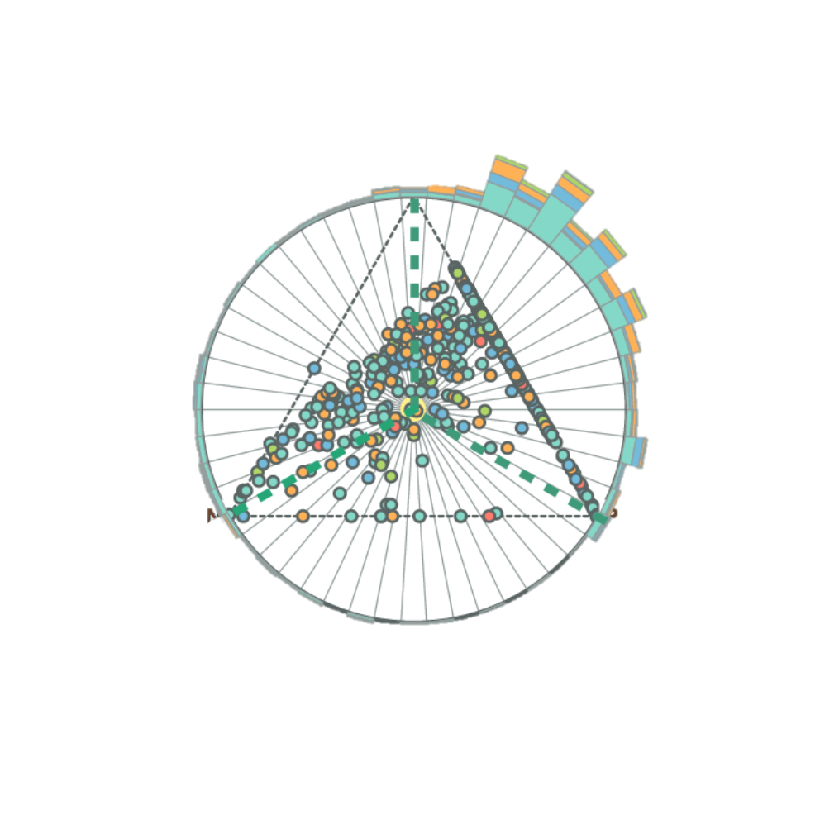
Triangle scatter plot
Opinion wheel
Stacked bar chart
Calendar ring
Geo ring
Connecting
line

Slide 19
Triangle scatter plot
Opinion wheel
Stacked bar chart
Calendar ring
Connecting
line
Geo ring

Slide 20
Triangle scatter plot
Opinion wheel
Stacked bar chart
Calendar ring
Geo ring
Connecting
line

